Slide 1
Cardiosave D.00/D.01 Software Revisions

Slide 2
Cardiosave D.00/D.01 Software Revisions
Introduction
This presentation aims to comprehensively explore the Cardiosave D.00/D.01 software revisions, highlighting the key features and operational improvements.
We’ll review significant changes affecting device operation, including new monitor messages, help screen information, and touchscreen enhancements.
Through detailed exploration of these updates, users will gain a deeper understanding of how to navigate and utilize the enhanced features of the Cardiosave D.00/D.01 software revision effectively.

Slide 3
Docking the IABP Console into the Hospital Cart

Slide 4


Docking the IABP Console into the Hospital Cart
Cardiosave ABP Configurations
The Cardiosave device has two configurations: Hybrid and Rescue (transport):
Hybrid Configuration
  On the Hospital Cart
  Operates on either AC or battery power
  Automatic battery recharging when connected to AC power source
Rescue (Transport) Configuration
  Off the Hospital Cart
  Typically used in transport settings
  Primary operation on battery power
  AC power usage possible with Transport Power Supply in one battery bay
    The Transport Power Supply does not recharge a second battery in the other bay

Slide 5
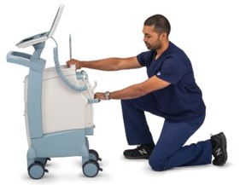
Docking the IABP Console into the Hospital Cart
Potential re-docking issues
  Potential re-docking issues with the Cardiosave IABP console
  Incomplete console insertion into hospital cart prevents AC power connection and battery charging.
  Incorrect console seating in hospital cart leads to battery-only operation
  Potential impact
  Users may mistakenly assume the IABP device is using AC power.
  Unexpected therapy interruptions can occur as batteries deplete, leaving users unprepared.

Slide 6
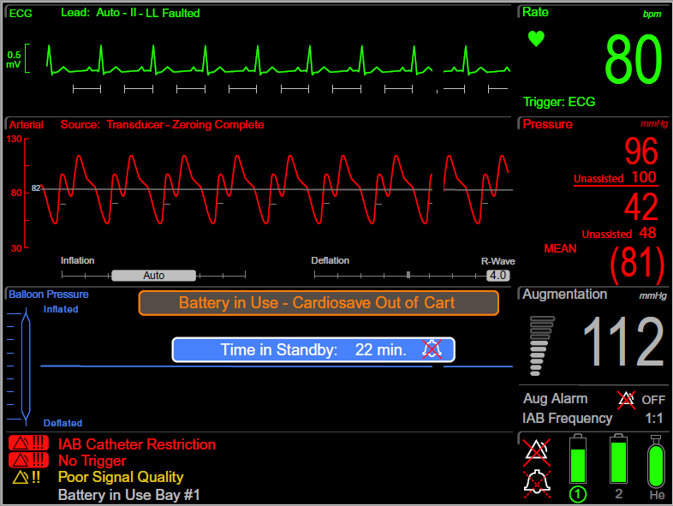
Docking the IABP Console into the Hospital Cart
Monitor Display - New “Battery in Use – Cardiosave Out of Cart” banner
A New visual alert, "Battery in Use – Cardiosave Out of Cart“ banner
Informs users whenever the console is undocked and relying on battery power.

Slide 7

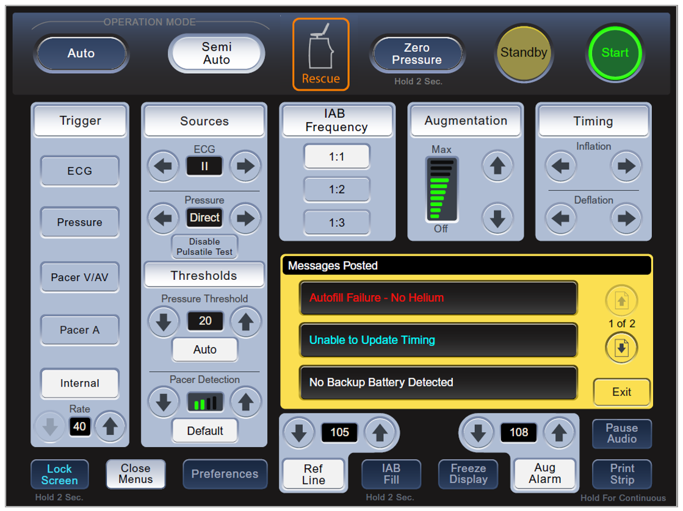
Docking the IABP Console into the Hospital Cart
Touchscreen – New Rescue visual indicator
New Rescue Visual Indicator: An orange border now encircles the Rescue icon on the touchscreen, signaling that the Cardiosave IABP console is undocked and operating on battery power.
  In Rescue Configuration: The orange border transitions from dark to light, indicating the undocked status.
  In Hybrid Configuration: Should the Rescue icon with the orange border appear, ensure that the Cardiosave IABP console is securely docked into the Hospital Cart; redock if required.

Slide 8
Docking the IABP Console into the Hospital Cart
Unintended Rescue (Transport) Configuration
Two Unintended Rescue (Transport) Configuration Scenarios:
The Cardiosave IABP console may unintentionally enter Rescue Configuration if the latch on the Hospital Cart is inadvertently released.
Improper redocking of the IABP console does not fully engage the console into the Hospital Cart.
Indicators for Rescue Configuration:
Icon for Rescue Configuration prominently displayed at the top center of the Cardiosave touchscreen.
"Battery in Use – Cardiosave Out of Cart" banner displayed on the Monitor Display.
The informational message "Battery in Use" persists, even when the Hospital Cart’s AC power cord is connected to an active AC power source.

Slide 9
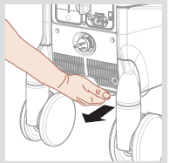
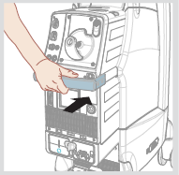
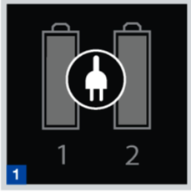
Docking the IABP Console into the Hospital Cart
Returning (redocking) the Cardiosave IABP console into the cart
    Release the latch on the Hospital Cart located below the IABP Console. [1]
    Slowly slide out the console about one quarter of the way using the handle. [1]
    Then, grab the handle and gently slide the IABP Console into the Hospital Cart until it locks with an audible click and three audio tones. [2]
    To ensure successful installation, plug the Hospital Cart power cord into a live, compatible, grounded AC receptacle and confirm AC operation by checking the battery icon for AC power usage. [3]
1
2
3

Slide 10
Software Version added to Preferences Menu

Slide 11
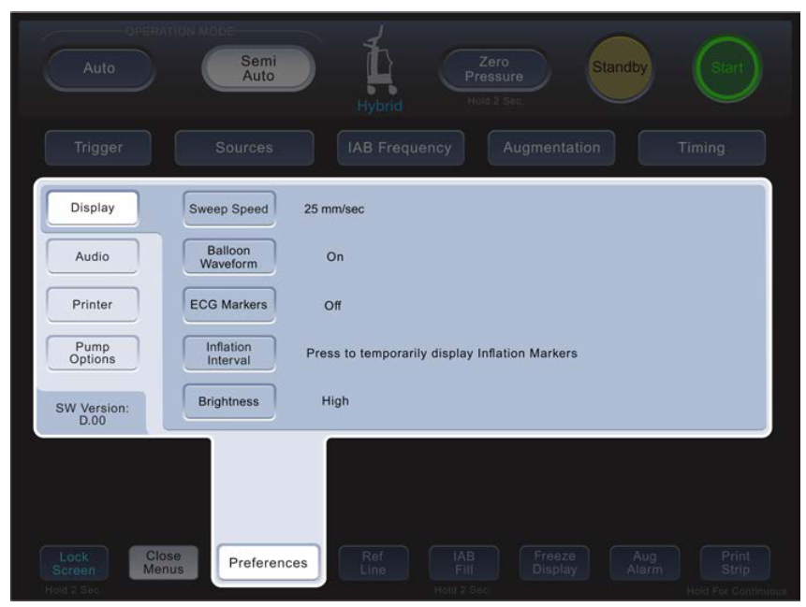

Software Version in Preferences Menu
New Easy Access to Software Version
New Easy Access to Software Version
With D.00 and D.01 software, users can now easily verify the current version on the Cardiosave during clinical mode.
Software Version Display
The installed software (SW) version is prominently displayed in the lower-left corner of the Preference Menu.
Identification of Software Version
An absence of software version information in this area indicates that the software has not been updated with D.00 or D.01 software versions.

Slide 12
System power down/power up

Slide 13
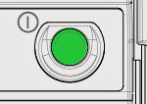
System power down/power up
New Power Button Functionality
Enhanced System Reliability
Addresses potential operational issues associated with rapid powering-down and powering-up the IABP.
New Power Button Functionality
  After powering-down, the system ensures a 10-second wait time before the Cardiosave can be restarted.
  The power button's LED will flash during this period, signaling the temporary restart restriction.
  Ensures safer power-down and power-up sequences.
Power Button
LED will flash

Slide 14
Battery Enhancements

Slide 15
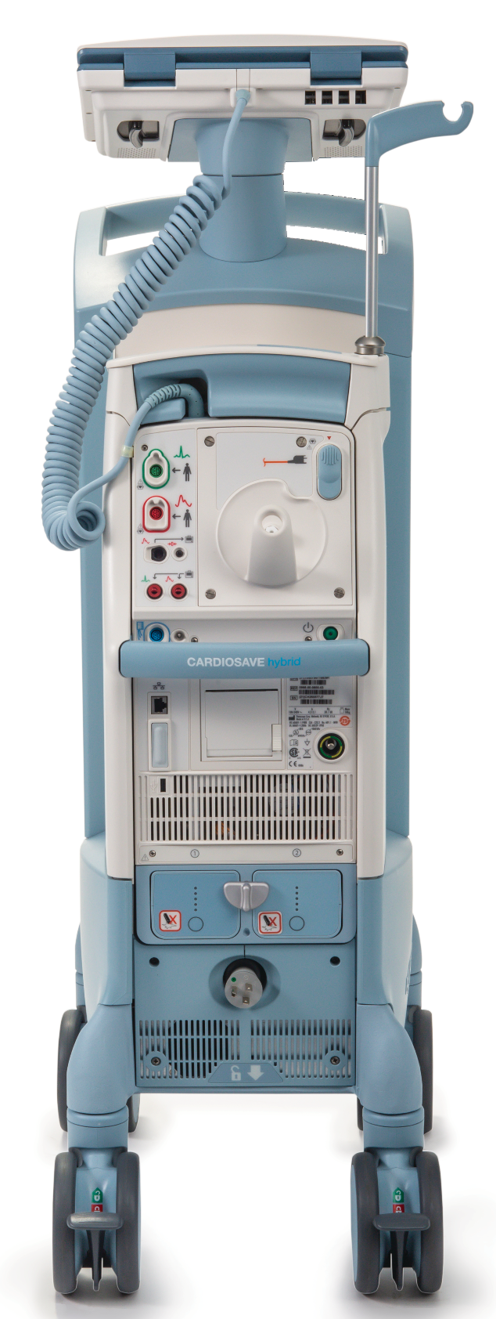
Unexpected Shutdown Upon Battery Removal
  Voluntary Medical Device Correction Initiated
  Datascope/Getinge proactively addressed an issue regarding potential unexpected shutdowns during battery removal.
  Before D.00/D.01 Software
    Under specific conditions, if the Cardiosave Hybrid IABP was operating on AC power with only one battery installed, and the battery was removed while charging, the device could unexpectedly shut down.
    After D.00/D.01 Software
  The device now detects the removal of an actively charging battery.
  It disconnects the battery charging system and seamlessly transitions to AC power, ensuring uninterrupted therapy.
Cardiosave Hybrid

Slide 16


Battery Charge Level Unavailable Bay #___
New High Priority Alarm
    Battery Information Display:
    A functioning battery may not display current information on the screen.
    System Enhancements for Battery Monitoring:
    To address this, a High Priority Alarm and a dedicated Help Screen are now integrated for immediate user awareness.
High priority alarm icon
Battery icon

Slide 17
Battery Charge Level Unavailable Bay #___
New High Priority Alarm
    Alarm Handling:
    This alarm does not suspend therapy.
    Immediate replacement of indicated battery is required.
    If a fully charged replacement battery is not available connect to an AC power source as soon as possible.
    If battery operation on the indicated battery is required, monitor the system closely for a system shutdown as the Low Battery Alarm will not be displayed.
    Contact Biomed/Technical Service to obtain a new battery.
High priority alarm icon
Battery icon

Slide 18
Battery Maintenance Required Bay #___
Newly added Informational Message
    The Informational Message is displayed if the previous maintenance date for the batteries is overdue.
    The Informational Message appears upon startup, staying on-screen for 5 minutes or until the Cardiosave IABP begins pumping (assistance).
    An informational audio alert accompanies the message, lasting for 60 seconds or until pumping starts.
    Message Reset Criteria:
      This Informational Message resets after battery maintenance, battery replacement, or when START is pressed to begin pumping.

Slide 19
Battery Maintenance Required Bay #___
Newly added Informational Message
    If this occurs during therapy initiation:
    Therapy may continue but replace identified battery when feasible.
    Until the battery is replaced, utilize AC power available.
    Monitor the system for a Low Battery alarm as run time may be reduced.
    If a Low Battery alarm occurs, immediately replace the battery or return to AC power.
    Once battery is removed or IABP use is discontinued, contact Biomed/Technical Service for battery evaluation.
    If battery maintenance is not performed, this message will reappear during subsequent initiation of therapy.

Slide 20
Battery Replacement Required Bay #____
Newly added Informational Message
    This message is posted when the indicated battery fails a system check for reliability.
    It appears on startup for 5 minutes or until the Cardiosave IABP begins assisting.
    The informational audio tone will sound for 60 seconds or until the pump initiates assistance.
    The alarm can be reset by either replacing the battery or pressing the START key to initiate therapy.
    If battery maintenance is overlooked, this message will reappear during the next startup.

Slide 21
Battery Replacement Required Bay #____
Newly added Informational Message
    If this occurs during therapy initiation:
    Therapy may continue but replace identified battery when feasible.
    Until battery replacement, use AC power if available.
    Monitor the system for a Low Battery alarm as run time may be reduced.
    If a Low Battery alarm occurs, immediately replace the battery or return to AC power.
    Once battery is removed or IABP use is discontinued, contact Biomed/Technical Service for battery evaluation.
    If battery maintenance is not performed, this message will reappear during the subsequent initiation of therapy.

Slide 22
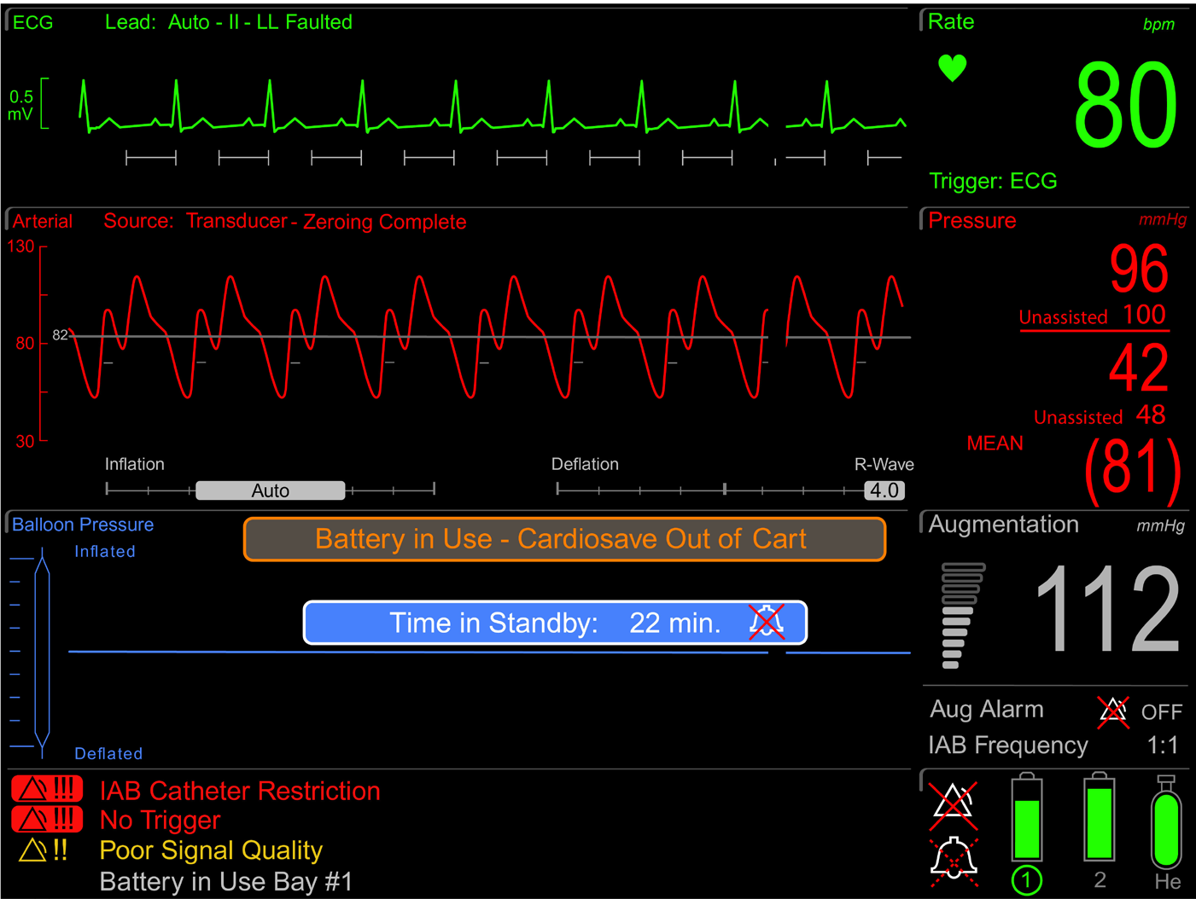
Battery in Use Bay #___
Battery Bay Indicator added to existing Informational Message
Enhanced Battery Awareness:
To improve awareness of the active battery, a battery bay indicator has been incorporated into the "Battery in Use Informational Message" on the Monitor Display.
The updated Informational Message identifies clearly which of the two batteries is presently being utilized.

Slide 23
New Low Battery Alarm
Existing Battery Alarm System
  A Medium Priority Alarm "Low Battery" activates when less than 30 minutes of cumulative battery operating time remains.
Introduction of New High Priority Alarm
  A High Priority Alarm "Low Battery" has been added to alert the end-user when the combined reserve of both batteries drops below 15 minutes of operating time.
Continuation of Therapy During High Priority Alarm
  Despite the new High Priority alarm, Cardiosave maintains active IABP therapy without interruption.
Alarm Handling
  The alarm message and associated tone are automatically reset once AC power is reconnected or a fully charged battery is installed.

Slide 24
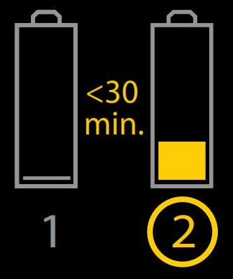
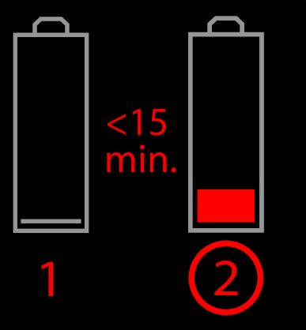
New Low Battery Alarm
Battery status on Monitor Display (examples)
Medium Priority alarm
Battery 1: Depleted
Battery 2: Less Than 30 Minutes of charge remaining.
High Priority alarm
Battery 1: Depleted.
Battery 2: Less than 15 minutes of charge remaining.

Slide 25
Cybersecurity vulnerabilities - Ripple20

Slide 26
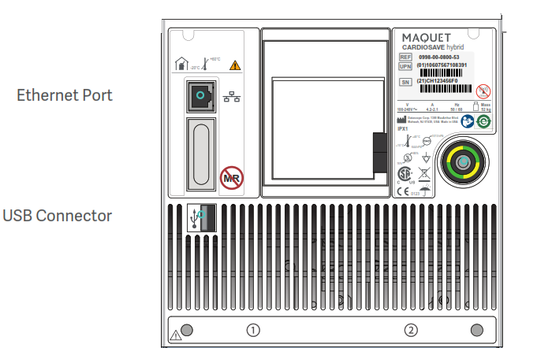
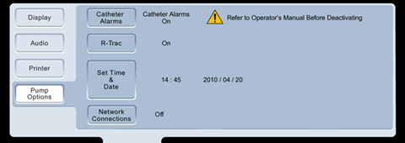
Cybersecurity vulnerabilities - Ripple20
Voluntary Medical Device Correction for Cardiosave IABP
  Getinge previously initiated a voluntary Medical Device Correction concerning the Cardiosave IABP, aimed at addressing cybersecurity vulnerabilities that could impact communication with Hospital/Clinical Information Systems (HIS/CIS).
Previous Guidance for Users
  As a precautionary measure, users were directed to disconnect the Ethernet cable from the Cardiosave Ethernet Port [See Figure 1] and to disable Network Connections.
Software Revision Resolution
  Both D.00 and D.01 software revisions have resolved the identified cybersecurity issues.
Instructions for Re-establishing Network Connectivity
  Following the update, users are instructed to reconnect the Ethernet cable and reactivate Network Connections through the Pump Options menu [See Figure 2].
Figure 1
Figure 2

Slide 27
Arterial Pressure (A.P.) surveillance

Slide 28
Arterial Pressure (A.P.) surveillance
No Pressure Source Available Alarm
Compliance with New Regulatory Standards
  This update ensures compliance with new regulatory standards that mandate the detection and alerting of risks associated with blood pressure monitoring faults.
Enhanced Monitoring Capabilities
  Cardiosave with C.06, D.00 & D.01 Software Versions now includes monitoring for prolonged loss of pulsatility in the arterial pressure waveform.
Medium Priority Alarm
  When a prolonged loss of pulsatility is detected, the system triggers a Medium Priority Alarm named "No Pressure Source Available," alerting users to the issue.

Slide 29
Arterial Pressure (A.P.) surveillance
No Pressure Source Available Alarm
The Cardiosave IABP now features an expanded list of new probable causes for the existing "No Pressure Source Available" alarm.
The updated help screen assists clinicians in swiftly identifying and addressing the following newly added probable causes:
Arterial pressure transducer vented to the atmosphere for over 10 seconds.
Disconnected arterial pressure monitoring tubing.
Possible clot formation in the IAB arterial pressure monitoring lumen, leading to a flat arterial pressure waveform.
Defective arterial pressure transducer or pressure transducer cable resulting in a flat arterial pressure waveform.

Slide 30
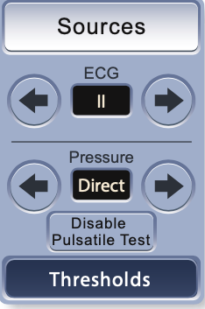
Arterial Pressure (A.P.) surveillance
Disable Pulsatile Test Key
New Disable Pulsatile Test key allows users to pause arterial pressure pulsatility monitoring:
When pulsatility is not present due to the integration of an IAB with non-pulsatile mechanical circulatory support systems.
Persistent occlusions, such as a clot in the IAB catheter’s inner lumen, may compromise pulsatility detection.
  In the event of a clotted IAB inner lumen, promptly secure an alternative arterial pressure source
Resuming arterial pressure pulsatility surveillance:
To resume arterial pressure pulsatility surveillance, users can press the Enable Pulsatile Test key.
The system will automatically resume this arterial pressure pulsatility surveillance check after detecting 30 continuous seconds of pulsatility on the waveform.

Slide 31
Enhanced Help Screens – D.01 Only

Slide 32
Enhanced Help Screens – D.01 Only
IAB Perforation Related Alarms
Reason for revision
Offers clinicians clear guidance for identifying and addressing suspected IAB perforations.
Aims to quickly reduce patient risk and the risk of blood entering the IABP to reduce the risk of subsequent patient exposure to unexpected biohazards.
Gas Gain in IAB Circuit
Autofill Failure-
Blood Suspected
Autofill Failure
Gas Loss in IAB Circuit
IAB Catheter Restriction

Slide 33
Enhanced Help Screens – D.01 Only
IAB Perforation Related Alarms
If any blood is visualized or perforation is suspected, perform the following procedure.
Stop pumping by placing IABP console in Standby.
Disconnect the catheter extender tubing from the IABP console to allow the balloon to deflate.
Clamp extracorporeal tubing between white y-fitting and male connector.
Notify physician and prepare for IAB catheter removal.
Consider IAB catheter replacement if the patient’s condition warrants.
If blood is suspected of having entered the pump, take pump out of service. It should be evaluated before use in another patient by Biomed/Technical Service to determine if replacement of contaminated components is necessary.
Gas Gain in IAB Circuit
Autofill Failure-
Blood Suspected
Autofill Failure
Gas Loss in IAB Circuit
IAB Catheter Restriction

Slide 34
Additional Warnings

Slide 35
Additional Warnings
Reason for revision
These warnings were added to the Cardiosave Operating Instructions to align with the warnings in the IAB IFUs.

Slide 36
Additional Warnings
Added Warnings
  Perforation of an IAB membrane may indicate that the patient’s vascular condition may induce abrasion or perforation in subsequent IAB membranes.
  If you continue to pump an IAB catheter with a leak, gaseous embolic injury of organs may result, or a large blood clot may form within the balloon membrane requiring surgical removal of the IAB catheter.
  Should an IAB membrane perforation occur, blood may be permitted to travel into the IABP console. To prevent blood loss and damage to the IABP console, stop therapy, disconnect catheter extender tubing from the IABP console, and clamp the extracorporeal tubing.
  The user and subsequent maintenance or service personnel can be exposed to an unexpected biohazard should proper containment precautions not be taken.
  Subsequent patients may be exposed to an unexpected biohazard should an impacted console not be appropriately.

Slide 37
Additional Warnings
Added Warnings (cont.)
  An unexpected shutdown due to a blood back event may threaten the hemodynamic stability of the supported patient as the User is left unaware of the status of the IABP. Additionally, any subsequent attempts to use a console that experienced a blood back event without reconditioning may delay future therapy delivery.
  Do not inflate the IAB using a syringe or any other means if a balloon membrane leak is suspected.
  During hospital use, it is advised another Cardiosave be available to provide therapy should the Cardiosave in use be compromised.
  It is advised not to transport a patient receiving counterpulsation therapy via Cardiosave unless the clinician deems the benefit of transport outweighs the risk of unexpected shutdown.

Slide 38
Cardiosave D.00/D.01 Software Revisions
Summary
The revisions reviewed in this presentation aim to elevate device safety, reliability, and usability of the Cardiosave IABP:
  Additional indicators for improved awareness of the Cardiosave Console’s docking status.
  Enhanced power management
  Battery enhancements
  Easy access to software version
  Cybersecurity updates
  Arterial pressure (A.P.) surveillance
  Enhanced Help Screens
  Additional warnings

Slide 39
Questions

Slide 40


MCA00002890 Rev A · Getinge and are trademarks or registered trademarks of Getinge AB, its subsidiaries, or aﬃliates in the United States or other countries · Copyright 2024 Datascope Corp. · All rights reserved · CAUTION: Federal (U.S.A.) law restricts this device to sale, distribution and use by or on the order of a physician. Refer to Instructions for Use for current indications, warnings, contraindications and precautions · 4/2024
Getinge · 45 Barbour Pond Dr., Wayne, NJ 07470, USA

